Slide 1







PEOPLE’S COMMITTEE OF TAN BINH DISTRICT
CHI LANG PRIMARY SCHOOL
Grade: 5
UNIT 1(cont)
The Ancient Mayans
Teacher: Hoàng Thị Thanh Thảo

Slide 2

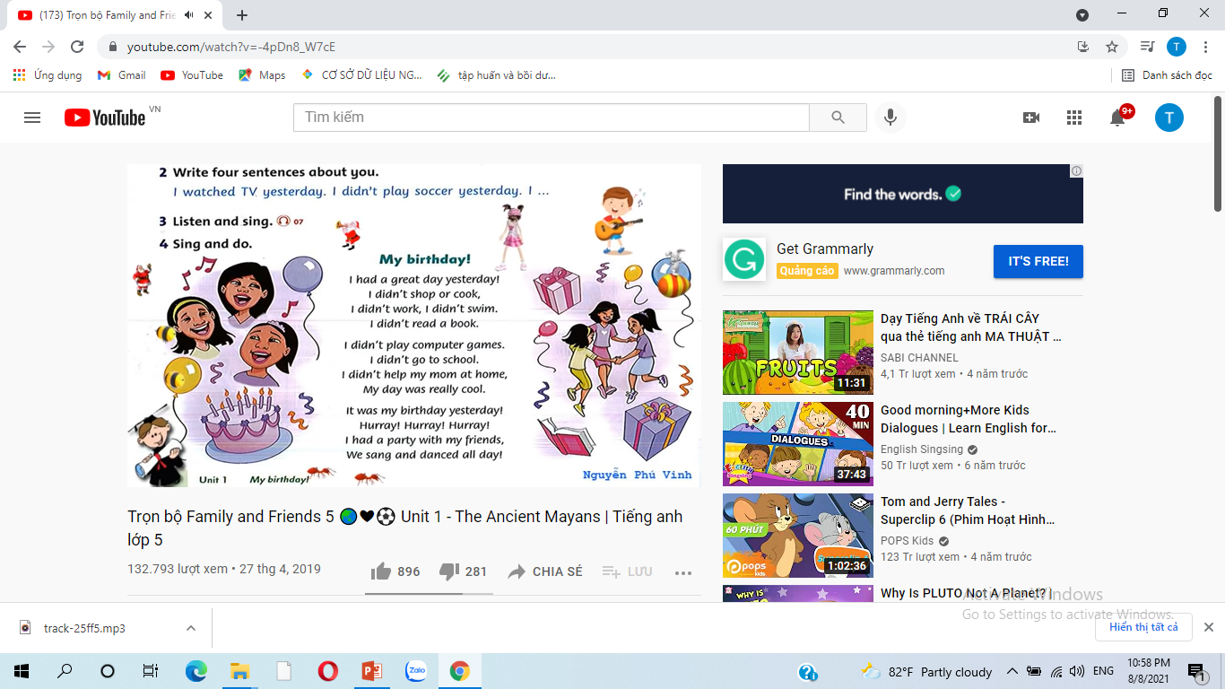
Listen and sing.
My birthday!
I had a great day yesterday!
I didn't shop or cook,
I didn't work, I didn't swim.
I didn't read a book.
I didn't play computer games.
I didn't go to school.
I didn't help my mom at home,
My day was really cool.
It was my birthday yesterday!
Hurray! Hurray! Hurray!
I had a party with my friends,
We sang and danced all day!

Slide 3
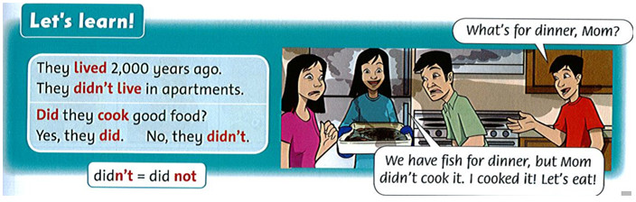

Slide 4

1. Listen, point, and repeat.
oo
moon | boot
ue
blue | glue
u_e
tune | tube
moon
boot
blue
glue
tune
tube

Slide 5
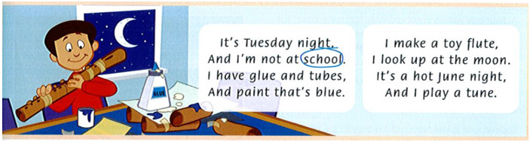
2. Listen and chant.

Slide 6
3. Read the chant again. Circle the words with oo, ue and u_e.

Slide 7
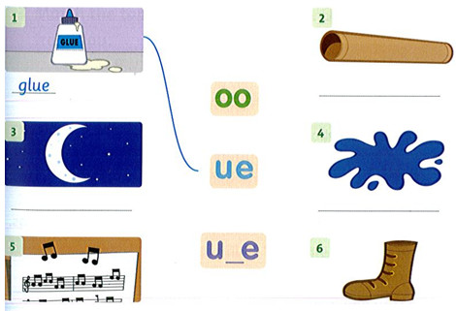
4. Match and write.

Slide 8
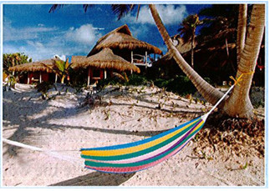
HAMMOCKS
Thousands of years ago, the Mayans used the bark from hamack trees to make a special kind of bed. These beds were hammocks. People used them to sit on or to sleep in. They were light and easy to carry. The Mayans often moved from place to place, and they didn’t want to carry heavy things.
The Mayans lived in rainforests. The weather was hot and there were lots of bugs, so it was difficult to sleep. Hammocks were perfect beds for the Mayans, because they weren’t on the ground.
At first, only people in hot countries had hammocks, but then a man called Christopher Columbus took hammocks to Europe. Soon, sailors on ships started to sleep in hammocks, because they were soft and comfortable.
Today, Mayan people in Central America still make hammocks, and people all over the world buy them to use in their backyards or homes.
Look around in Viet Nam and it is easy to see people reading, sleeping, and drinking in hammocks. They are everywhere — in people's houses, in cafes, and at the beach. Does your family have a hammock?
Underline these words in the text. Guess their meanings and then check them in the dictionary.
heavy: nặng
light: ánh sáng
soft: mềm
easy: dễ dàng
difficult: khó

Slide 9
HAMMOCKS
Thousands of years ago, the Mayans used the bark from hamack trees to make a special kind of bed. These beds were hammocks. People used them to sit on or to sleep in. They were light and easy to carry. The Mayans often moved from place to place, and they didn’t want to carry heavy things.
The Mayans lived in rainforests. The weather was hot and there were lots of bugs, so it was difficult to sleep. Hammocks were perfect beds for the Mayans, because they weren’t on the ground.
At first, only people in hot countries had hammocks, but then a man called Christopher Columbus took hammocks to Europe. Soon, sailors on ships started to sleep in hammocks, because they were soft and comfortable.
Today, Mayan people in Central America still make hammocks, and people all over the world buy them to use in their backyards or homes.
Look around in Viet Nam and it is easy to see people reading, sleeping, and drinking in hammocks. They are everywhere — in people's houses, in cafes, and at the beach. Does your family have a hammock?
Underline these words in the text. Guess their meanings and then check them in the dictionary.
heavy: nặng
light: ánh sáng
soft: mềm
easy: dễ dàng
difficult: khó

Slide 10
Read again and complete the sentence.(page 12)
heavy, light, soft, difficult, easy (x2)
1. Hammocks weren't heavy. They were light .
2. Hammocks were _____ to carry.
3. The Mayans moved from place to place, so they didn't want to carry _____ things.
4. It was _____ to sleep in hot weather.
5. Hammocks were _____ , so they were comfortable to sleep in.
6. It is _____ to see hammocks in Viet Nam.
easy
heavy
difficult
soft
easy

Slide 11
Questions
Ex. What did the Mayans use to sleep in ? ….They used hammocks ….. to sleep in.
1. Why didn’t the Mayans want to carry heavy things?
Because they often moved ……………………………………….………
2. Why were hammocks perfect beds for the Mayans?
Because the hammocks weren’t ……………………...………..…..……
3. Who took hammocks to Europe ?
…………………………………….… took hammocks to Europe.
4. Who had hammocks first?
…………………………………………. had hammocks first.
5. Why did sailors on ships sleep in hammocks?
Because hammocks were ……………………………
6. Do Mayan people in Central America still make hammocks?
…………………………
7. Where can we see hammocks in Viet Nam?
In Viet Nam we can see hammocks at …….……………………

Slide 12
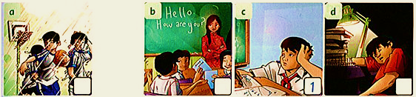
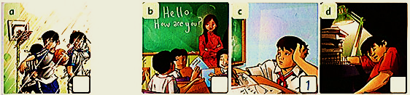
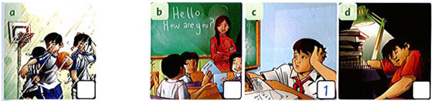
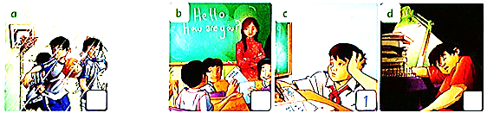
Listen and number
3
2
1
4
Script:
1. B. Hello….! How are you?
A. Not great. I had a terrible day yesterday.
B. Why?
A. Well, I had a math lesson in the morning. The questions were very difficult. And I didn't know the answers.
B. Oh, dear!
2. A. I had an English lesson in the afternoon.
B. That's good! You like English?
A. Yes. But I didn't have my homework so the teacher was angry.
B. Oh, no!
3. A. I played basketball with my friends in the park after school.
B. Last night?
A. It was nice. But then it started to rain. I was very wet and very cold.
B. Oh, no!
4. A. I had lots of difficult homework yesterday, too.
B. Oh, no!
A. So I worked for 3 hours.
B. For 3?

Slide 13
. Match the topics to the paragraphs.(page13)
1. House 2. Food 3. Children | a. Food b. ________ c. _________ | In my country, Viet Nam, a lot of food is made from rice, meat, and vegetables. Food is important, especially at festivals Like Tet. We also have great street food! Houses in Viet Nam are often tall and thin and sometimes brightly-colored. A normal house might have two floors. Children, parents, and grandparents often live in the same house. In cities, more and more people are living in apartments. Children in Viet Nam normally go to school from early in the morning. There are some schools that have two school days in one day. Some children study in the morning, and then other children study in the afternoon.
House
Children

Slide 14
Homework
Learn by heart new words
and do exercises pages 8,9,10,11,12,13 in workbook.

